Slide 1
Network traffic protocol fingerprinting
دينا محمد عبدالرحيم
هندسه حاسبات
Aالمرحله الثالثه
م.م المنتظر محمود

Slide 2
Introduction
What is Protocol Fingerprinting?
It is the process of identifying the type of network traffic (e.g.,HTTP,SSH,DNS)
Unlike traditional methods, it doesn't depend only on Port Numbers.
It analyzes the "behavior" and "patterns" of the data packets.

Slide 3
Features Extraction
Key Features Used:
Packet Length: The size of each data packet in bytes.
Inter-Arrival Time (IAT): The time difference between two consecutive packets.
Why these features?
Because each protocol has a unique signature in how it sends data.

Slide 4
Implementation - The Algorithm
Programming Language: Python.
Model: Random Forest Classifier.
Why Random Forest?
Handles non-linear data effectively.
High accuracy in classifying network protocols.
Robust against noise in traffic data.

Slide 5
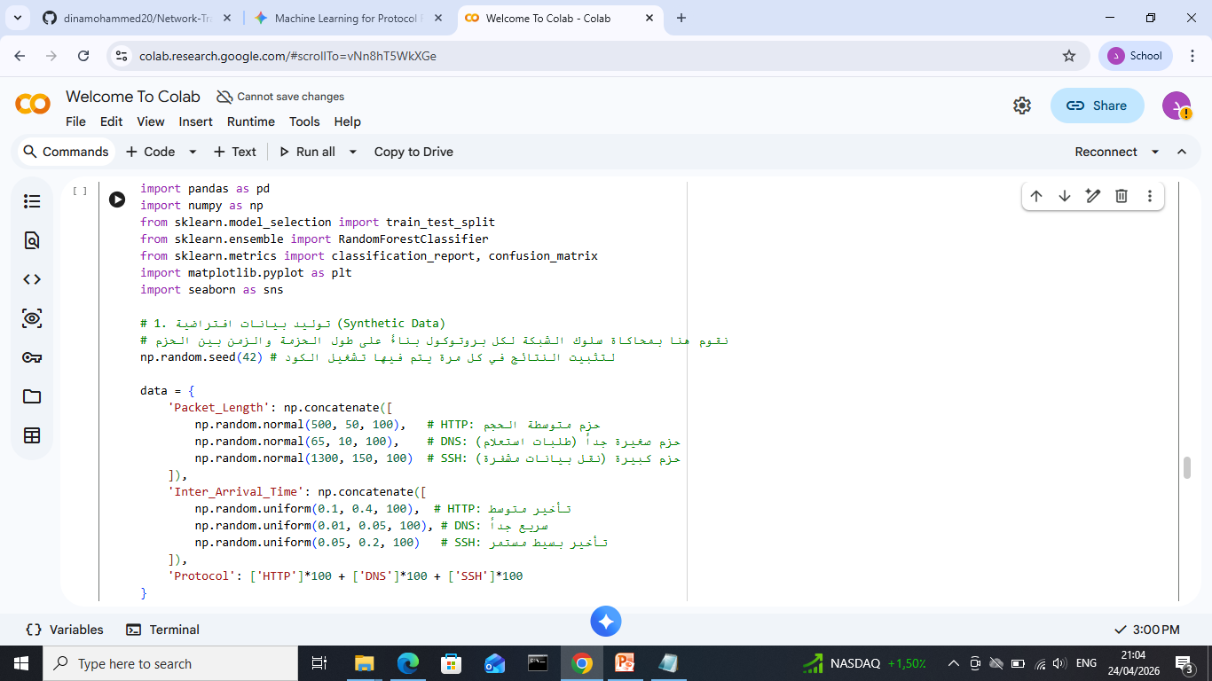
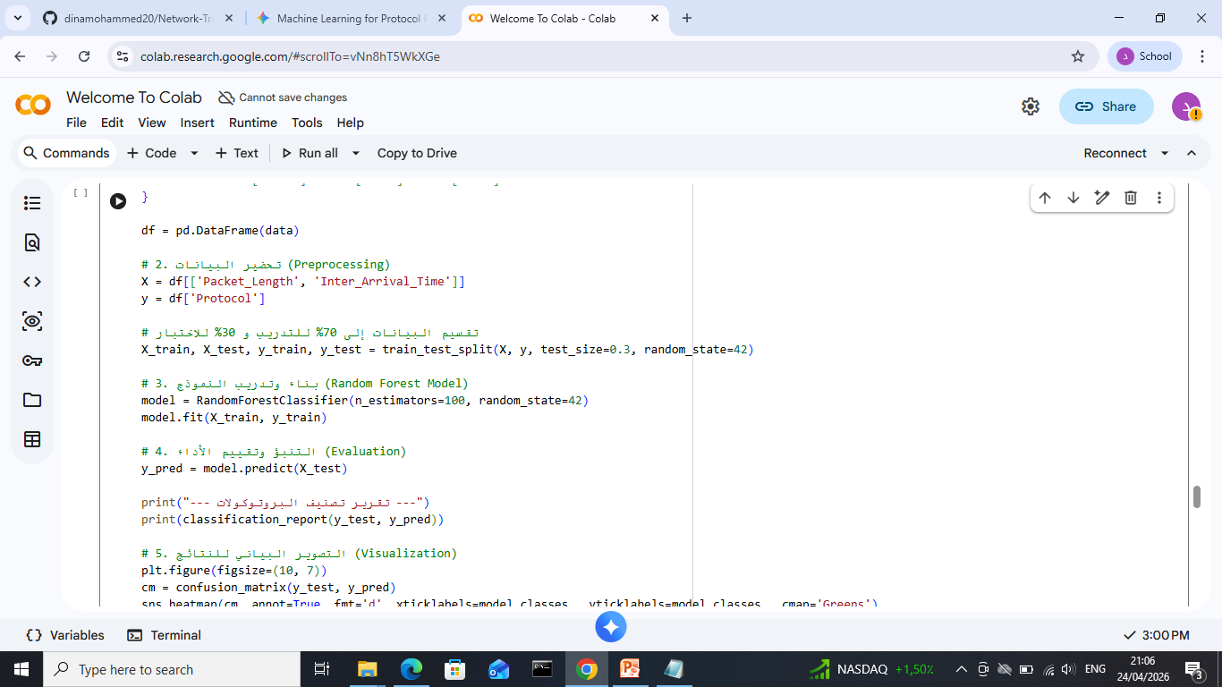
Implementation & Execution

Slide 6
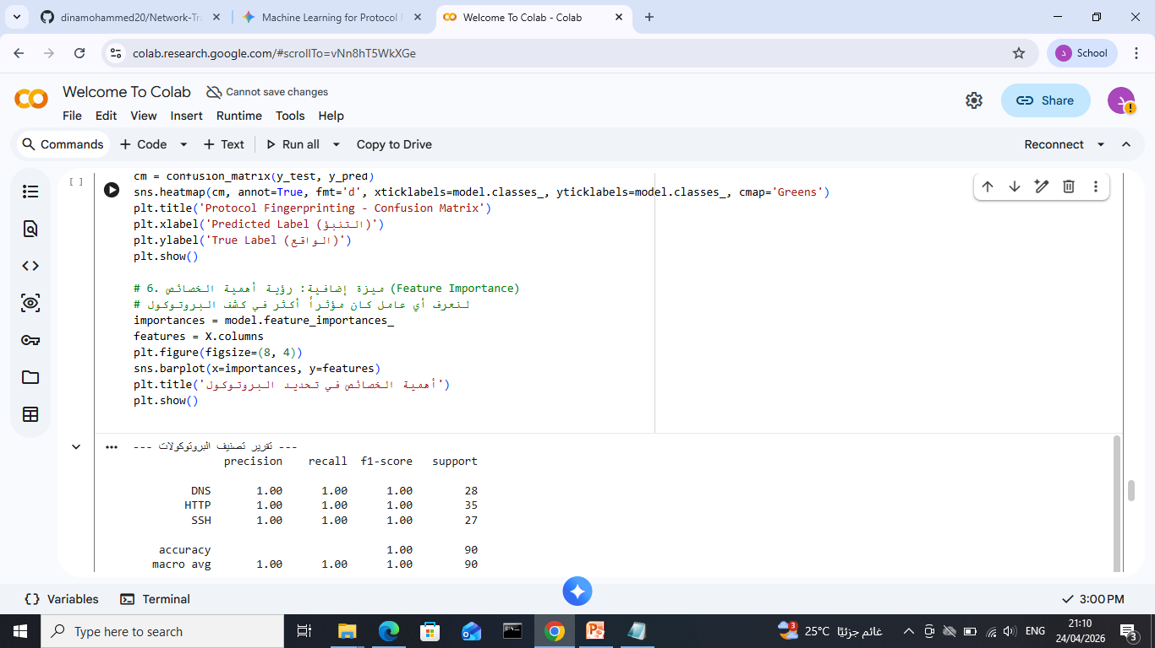
Implementation & Execution

Slide 7
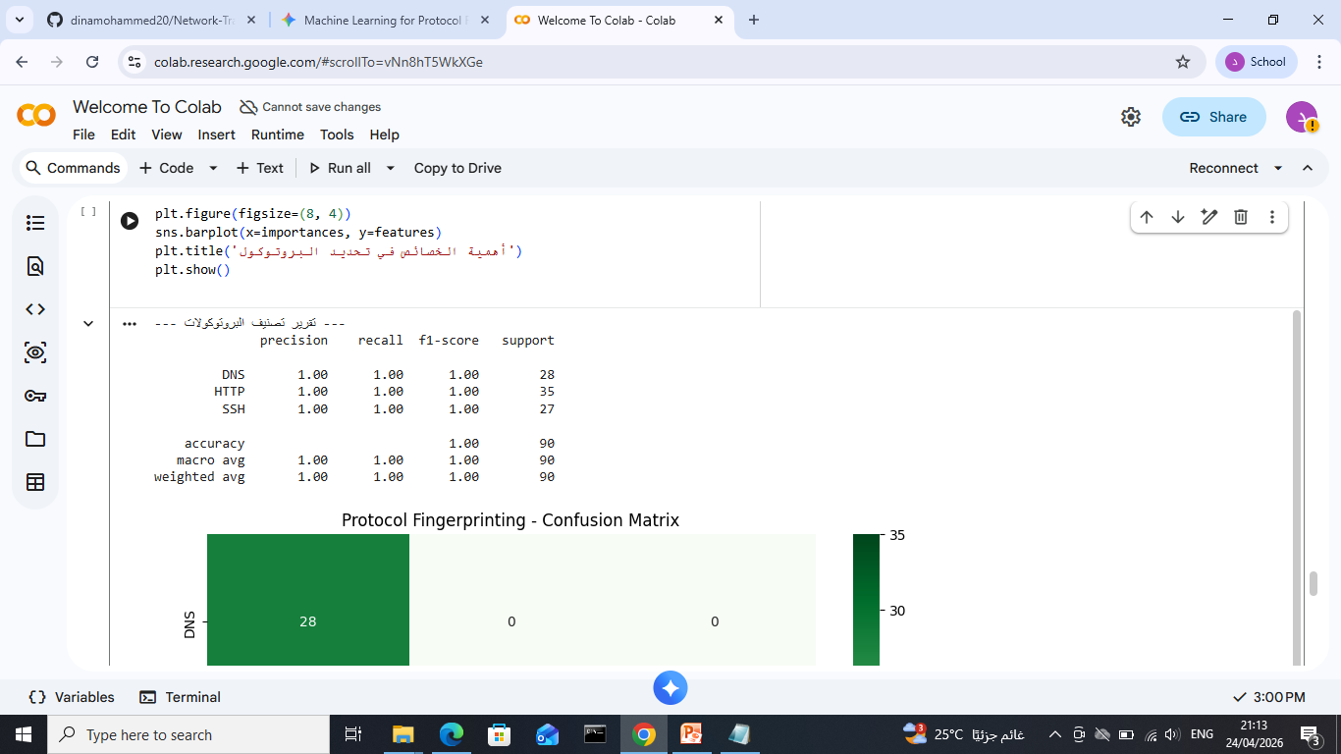
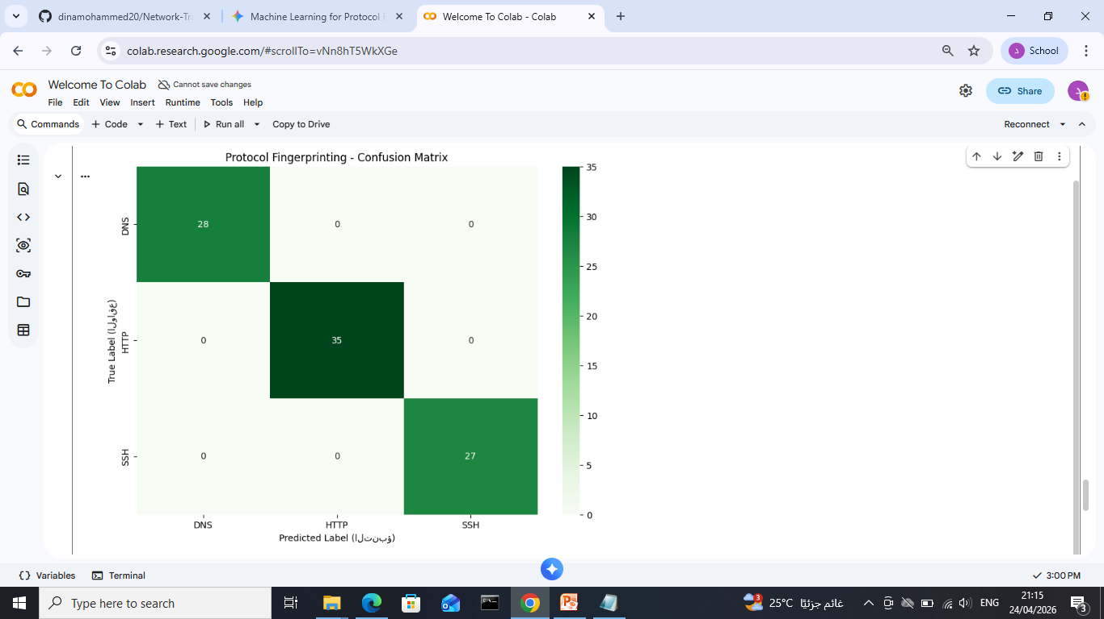
Results - Confusion Matrix
The "Diagonal" cells show correct classifications.
The model successfully distinguished between HTTP, DNS, and SSH with high precision.

Slide 8
Conclusion & GitHub Link
Conclusion: Machine learning is a powerful tool for network security and traffic management.
Project Link: [https://github.com/dinamohammed20/Network-Traffic-Protocol-Fingerprinting.git]
Thank You! Any Questions?

